Slide 1
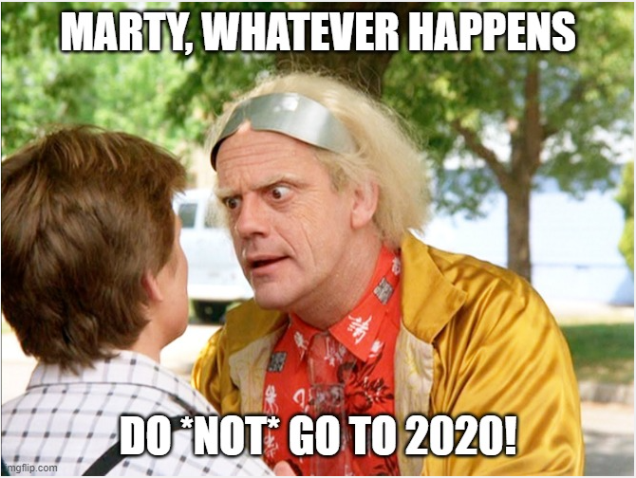
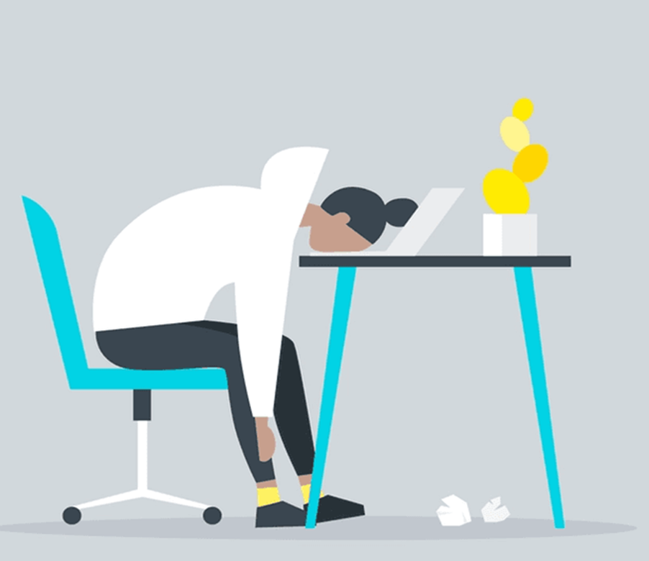

Burnout
more than just a bad day!

Slide 2
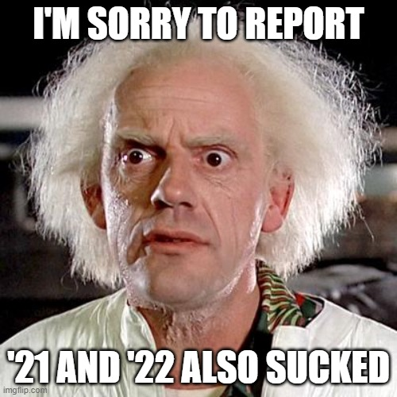
Burnout
more than just a bad day!

Slide 3
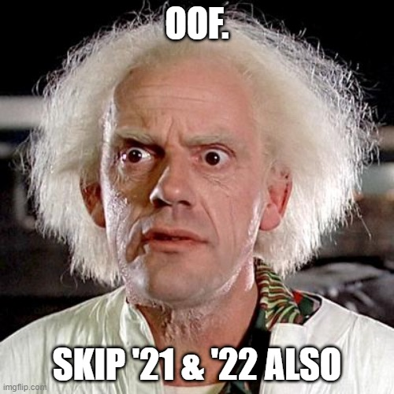
Burnout
more than just a bad day!

Slide 4
Burnout
more than just a bad day!
Employed Americans reporting worker burnout
76%

Slide 5
Burnout
more than just a bad day!
Employed Americans reporting complete burnout
9%

Slide 6
Today’s agenda
Burnout
more than just a bad day!
Employed Americans w/ no ideas for reducing burnout
Understanding burnout
Diagnosing and evaluating burnout
1 in 10
Treating / managing burnout

Slide 7
Burnout
more than just a bad day!
Employed Americans w/ no ideas for reducing burnout
1 in 10
Today’s agenda
Understanding burnout
Diagnosing and evaluating burnout
Treating / managing burnout

Slide 8
Employed Americans w/ no ideas for reducing burnout
1 in 10
Burnout
more than just a bad day!
Today’s agenda
Understanding burnout
Diagnosing and evaluating burnout
Treating / managing burnout

Slide 9
Burnout
more than just a bad day!
Burnout is a state of
emotional, physical, and mental exhaustion
caused by excessive and prolonged stress
Today’s agenda
Understanding burnout
Diagnosing and evaluating burnout
Treating / managing burnout

Slide 10
Burnout
more than just a bad day!
Burnout is a state of
emotional, physical, and mental exhaustion
caused by excessive and prolonged stress
Pandemic
Inflation
Politics
Job insecurity
Family stress
WFH / RTO
Adulting
Turnover

